Slide 1
Data Encoders
Score Prediction and Commentary Sentiment analysis

Slide 2
Contents
Data Source
Data Extraction
Data Analysis
Data Visualization
Demo

Slide 3
Commentary sentiment analysis

Slide 4
Work Division
Implementation of Python Programming: Raghunandan
Analysis of Commentary: Dheeraj

Slide 5
Data Source
We are considering data from the web source known as www.crickbuzz.com to analyze the commentary for that cricket match.

Slide 6
Data extraction
This website contains an API called as “pycricbuzz” which is exclusively used to extract data using python programming.
So we will be extracting only the commentary from the web source by writing queries in python.

Slide 7
Data Analyzing and Visualization
Data Analysis is done by using a separate package called as NLTK which is abbreviated as Natural Language Toolkit.
The data thus obtained will be visualized by using python programming.

Slide 8
Demo

Slide 9
Score Prediction

Slide 10
Work Division
Implementation of Kafka: Raghunandan
Connecting MongoDB to PowerBI : Nikitha Kethireddy
Data Transformations: Deepthi Chokka
Data Visualization: Jeevan

Slide 11
Data Source
We are considering data from the web source known as www.crickbuzz.com to visualize and analyze and predict the score for the succeeding over.

Slide 12
Data Extraction
First we will be running zookeeper and kafka by using the following commands:
.\bin\windows\zookeeper-server-start.bat .\config\zookeeper.properties
.\bin\windows\kafka-server-start.bat .\config\server.properties
open MongoDB installed within local system and MongoDB connector to PowerBI.
run the producer and consumer for the customized project.

Slide 13
Data Connector
consumer processes the data by using Java and stores the end-result using MongoDB.
The reason for using MongoDB is that, it’s used to store the streamed data and also it acts as a middleware between Kafka and PowerBI.
We will be using ODBC connection by following the instructions in the link https://www.progress.com/blogs/mongodb-odbc-driver-for-data-integration-with-power-bi

Slide 14
Data Analyzing and Transformation
Open the required files
Perform operations
perform group-by operation upon the unique id generated
Find maximum score
Calculate run rate of the team by dividing score with overs.
Calculate estimated score

Slide 15
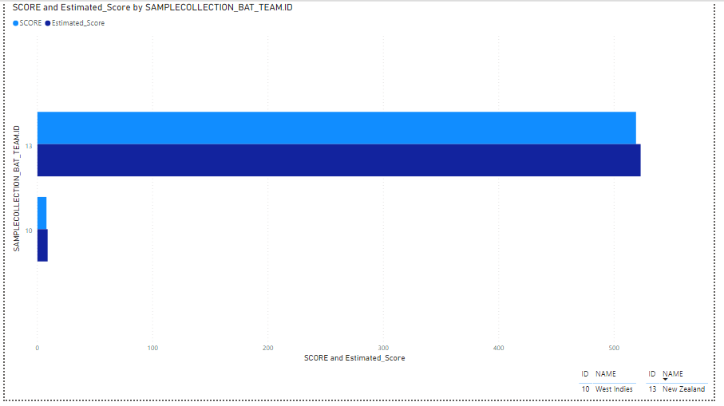
Data Visualization
We will be visualizing the data using Power BI.
The data will be visualized as the image shown.

Slide 16
Demo

